Slide 1
Tackle Sensor PCB
Jon Bayert
Oc-20-2020
https://github.com/jbayert/TackleSensorPCB

Slide 2
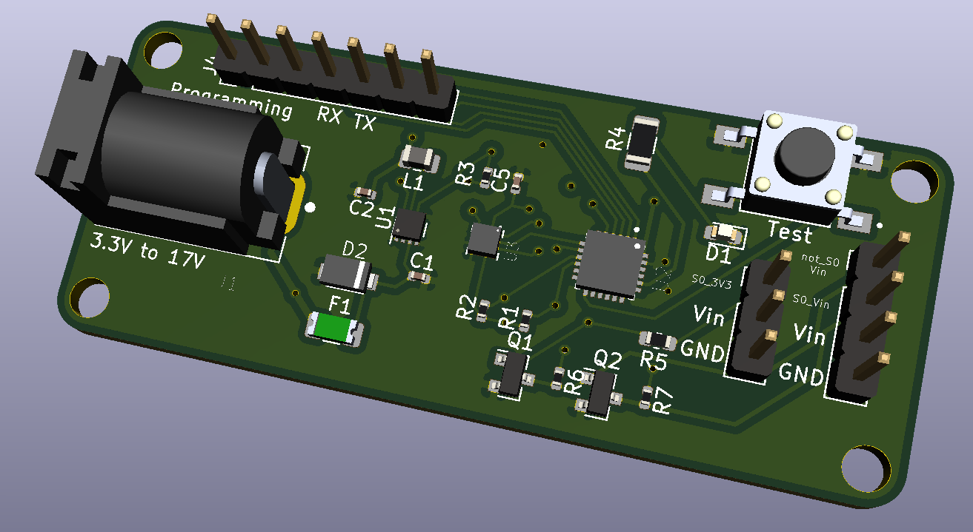

Slide 3
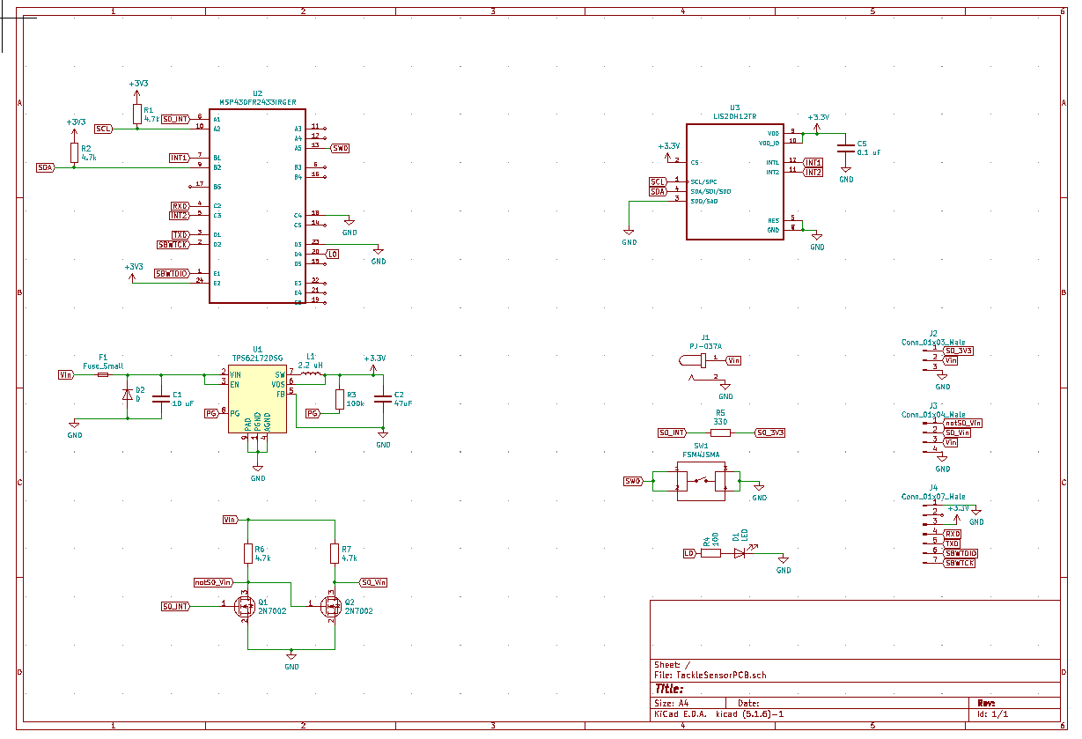

Slide 4
Assembly
Send out for SMD assembly. We just must flash it.
Should cost $15-20. Bulk (50+ish) could bring that down

